Slide 1
FPGA History & Architectures
2

Slide 2
FPGA
FPGA: (Field‐Programmable Gate Array)
Pre fabricated silicon Pre‐devices that can be electrically programmed to become any kind of digital circuit or system
A very large array of programmable logic blocks surrounded by programmable interconnects
Contains logic blocks instead of AND/OR planes (multi‐level logic of arbitrary depth)
Can be programmed by the end‐user to implement specific applications
Capacity up to multi‐millions gates
Clock frequency up to 1000MHz
2

Slide 3
FPGA Applications
Popular applications:
Prototyping a design before the final fabrication (using single FPGA)
Emulation of entire large hardware systems (using multiple FPGAs)
Configured as custom computing machines
Using programmable parts to “execute” software rather than software compilation on a CPU
On‐site hardware reconfiguration
Low‐cost applications
DSP, logic emulation, network components, etc…
2

Slide 4
FPGA History
First SRAM‐based FPGA by Wahlstorm 1967
First modern‐era FPGA by Xilinx 1984
64 logic blocks
58 input/outputs
Today:
Four main manufacturers (Altera, Xilinx, Actel, Lattice)
Over 300,000 logic blocks
Over 1100 input/outputs
2

Slide 5
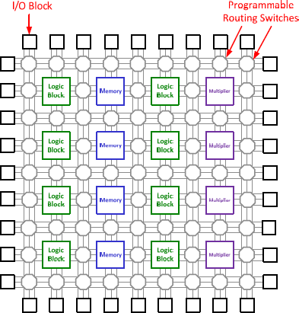
FPGA Architecture
FPGAs consists of 3 main resources:
1. Logic Blocks
General logic blocks
Memory blocks
FPGA Multiplier blocks
2. Program. Routing Switches
Programmable horizontal/vertical routing channels
Connecting blocks together and I/O
3. I/O Blocks
❑ Connecting the chip to the outside
2

Slide 6
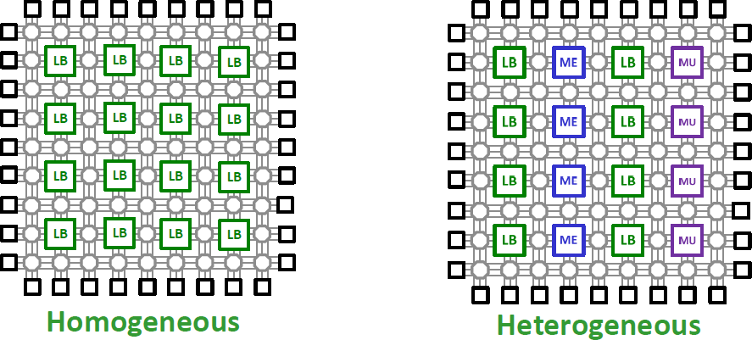
FPGA Categories (Structural)
There are two main categories of FPGAs in terms of their structure:
Homogeneous:
Employs only one type of logic block
Heterogeneous:
Employs mixture of different blocks such as dedicated memory/multiplier
Very efficient for specific functions
Might go waste if not used!
2

Slide 7
FPGA Categories (Structural)
There are three main categories of FPGAs in terms of their architecture:
Fine‐grained: (early stages)
Logic Block (LB) consists of logic gates plus a register
Coarse‐grained: (more efficient) LB consists of logic gates, MUXs Multi‐bit ALU
Multi‐bit registers
Platform FPGAs:
Sophisticated logic blocks
CPU (PowerPC) to run some functions in software PCI bus
RAM, PLL
Very fast Gbps transceivers for high‐speed serial off‐chip communication
2

Slide 8
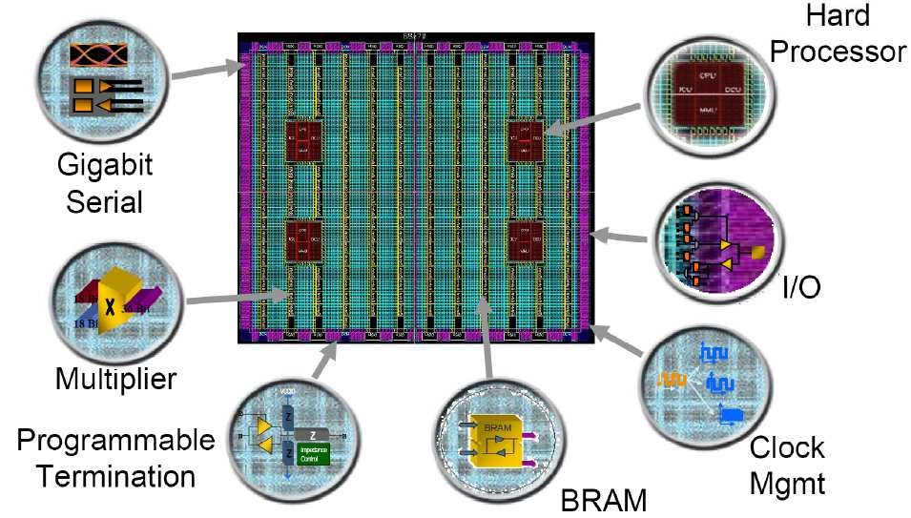
Modern Commercial FPGAs
2

Slide 9
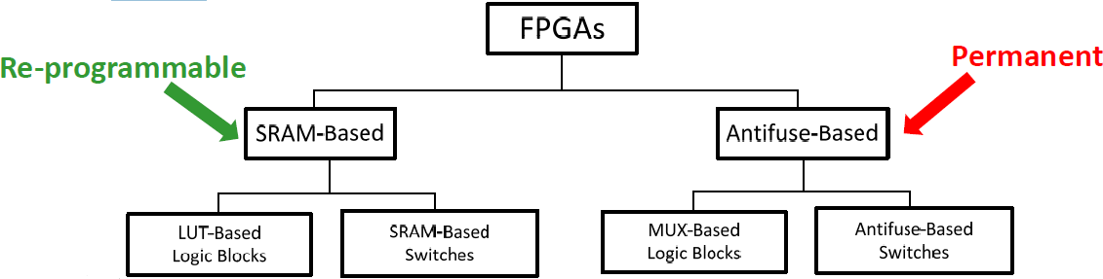
FPGA Categories (Fabrics)
There are two main categories of FPGAs in terms of their fabrics:
SRAM‐based FPGAs (Xilinx, Altera) [Re‐programmable, Re‐configurable]
Using Lookup Tables (LUTs) to implement logic blocks
Using SRAM‐cells to implement programmable switches
Antifuse‐based FPGAs (Actel, Lattice, Xilinx, QuickLogic, Cypress) [Permanent]
Using multiplexers (MUXs) to implement logic blocks
Using antifuses to implement programmable switches
2

Slide 10
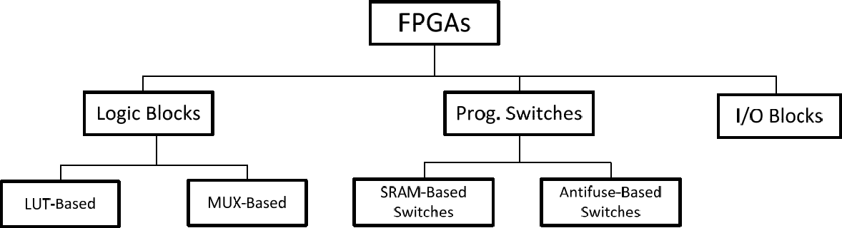
FPGA Categories (Block Fabrics)

Slide 11
Logic Block
The logic block is the most important element of an FPGA, which provides the basic computation and storage elements used in digital logic systems
Logic blocks are used to implement logic functions
A logic block has a small number of inputs and outputs
The logic block of an FPGA is considerably more complex than a standard CMOS gate b/c:
A CMOS gate implements only one chosen logic function
An FPGA logic block must be configurable enough to implement a number of different functions

Slide 12
Logic Block Design
Transistors as the basic logic block (fine‐grained)
Build gates & storage elements from it
Tried in Crosspoint
Drawbacks:
Requires huge amount of Prog. interconnects to create a typical logic function
Low area‐efficiency (b/c Prog. switches are area intensive)
Low performance (b/c each routing hop is slow)
high power consumption (higher interconnects capacitance to charge and discharge)
Processors as the basic logic block (coarse‐grained)
Drawbacks:
Incredibly inefficient for implementing simple functions
Less performance than customized hardware
Logic blocks should be designed as something in between
12

Slide 13
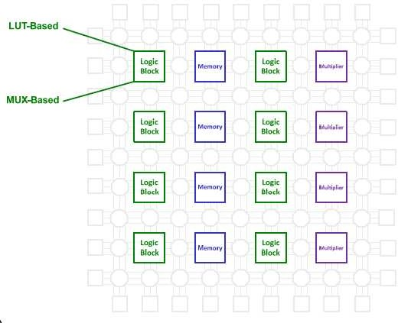
Logic Block Technologies

Slide 14
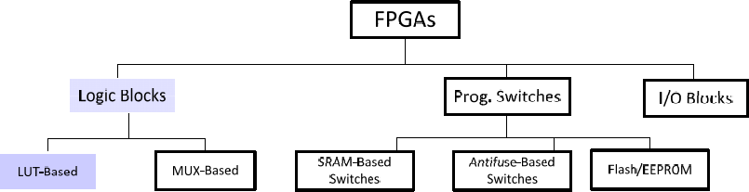
Where are we?

Slide 15
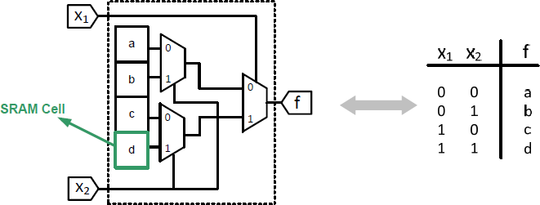
LUT Based Logic Block
Lookup Table (LUT)
Uses a set of 1‐bit storage elements to implement logic functions
Example:
A 2‐input LUT
Capable of implementing any logic function of two variables
15

Slide 16
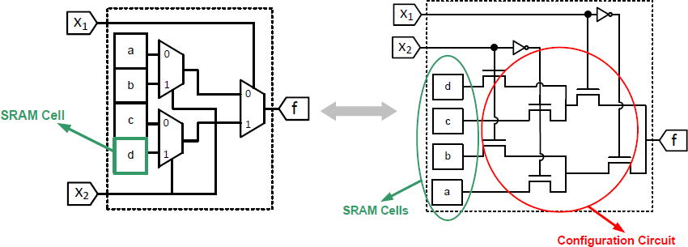
LUT Based Logic Block
Lookup Table (LUT) consists of:
Memory (SRAM Cells)
Configuration circuit that selects the proper memory bit
16

Slide 17
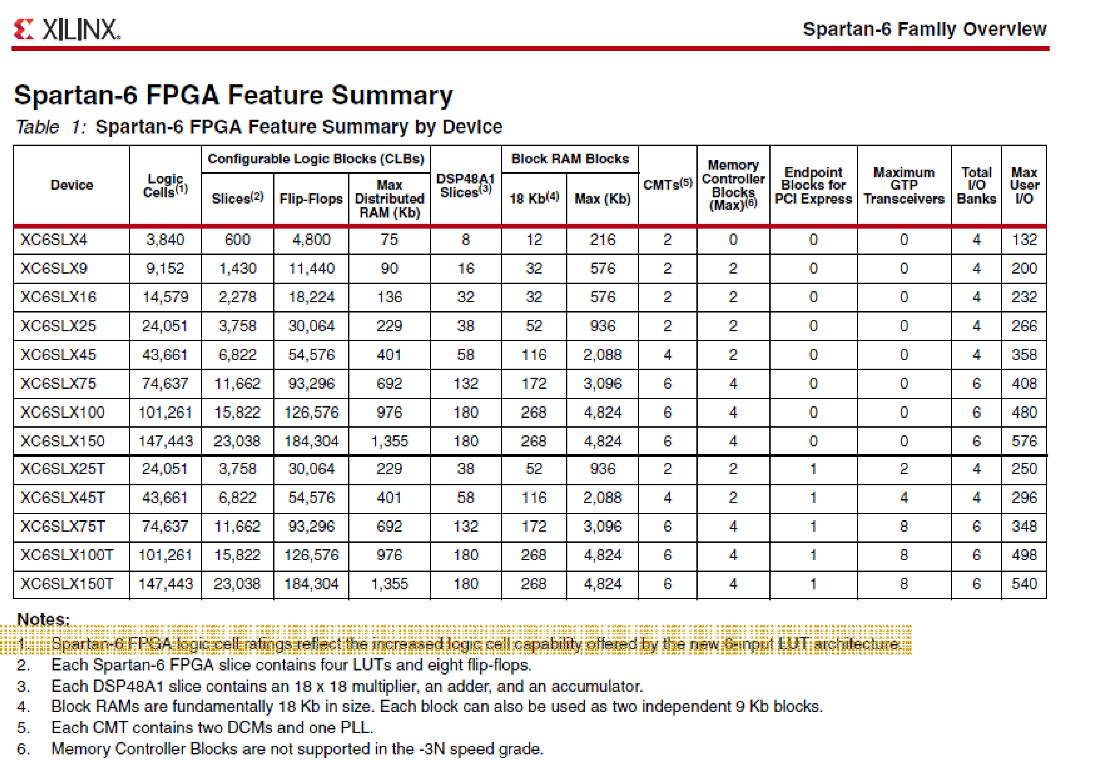
LUT Based Logic Block (Ex)
17

Slide 18
LUT Based Logic Block (Ex)
A typical logic block in commercial FPGAs has 4‐6 inputs
4‐input LUTs:
Xilinx XC4000
Xilinx Virtex family up to and including Virtex 4 Altera FLEX, Cyclone, Stratix I
Fracturable 6‐input LUTs: (a.k.a Adaptive Logic Module (ALM) ) Xilinx Virtex 5
Altera Stratix II

Slide 19
LUT Based Logic Block
Storage cells in the LUT are SRAM cells that are “volatile”
Lose their values when the power supply turns off Therefore, FPGA has to be re‐programmed again
Often a small memory chip, programmable read only memory (PROM) is used to hold their contents permanently
LUT values are loaded automatically from the PROM when power is applied to the chip

Slide 20
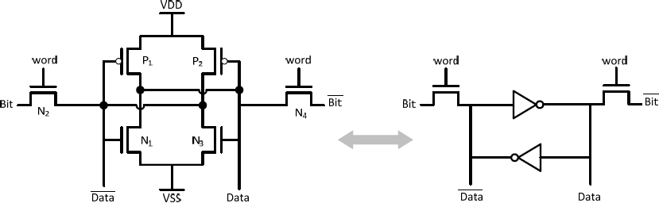
SRAM Cell used in LUT based FPGAs
The value is stored in the middle four transistors
These four transistors form a pair of inverters connected in a loop
“word=0” SRAM cell stores the value
“word=1” Read/Write is performed

Slide 21
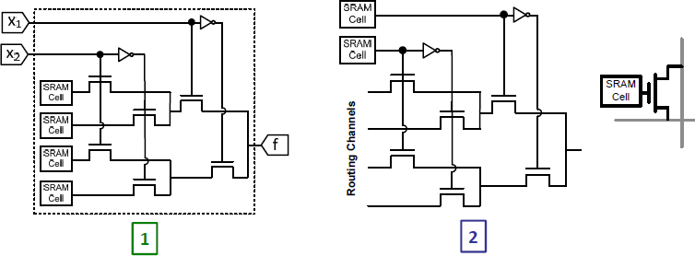
SRAM Cell
Two primary uses:
To store data in LUTs to implement logic functions Uses only one side of the cell (e.g., Bit)
To set the select lines in the programmable interconnects

Slide 22
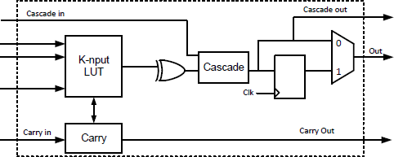
LUT-based Logic Block
LUT‐based logic blocks in most commercial FPGAs have some additional elements for efficient implementation (better than their LUT‐based realizations)
Extra elements inside LUT‐based logic blocks: (Soft Logic)
LUT
Flip‐flops, MUXs
Blocks to support arithmetic carry, sum, and subtraction functions
Cascade (to implement wide AND and larger functions)

Slide 23
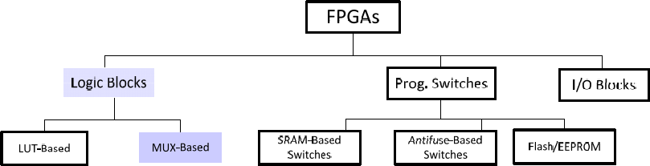
Where are we?

Slide 24
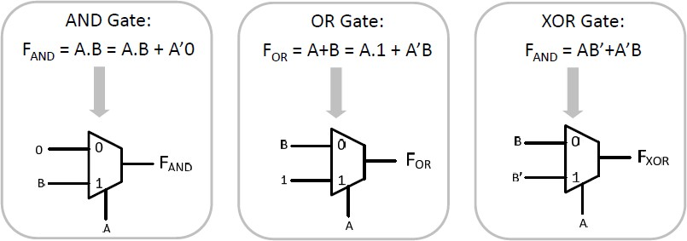
MUX‐Based Logic Block (Used in Antifuse‐Based FPGA)
The logic block in antifuse‐based FPGAs are generally based on multiplexing
Functions can be realized using MUXs based on Shannon’s expansion

Slide 25
Comparison b/w MUX based and LUT based
LUT‐based Logic Block (LB) using SRAM cells:
An n‐input LUT function requires 2^{n} SRAM cells
Each SRAM cell requires 8 transistors
e.g., a 4‐input function requires 16x8=128 transistors
Decoding circuitry is also required
e.g., decoder for a 4‐input LUT is a MUX with 96 transistors
Delay of LUT is independent of the function implemented and is dominated by the delay through the SRAM cell (same for all functions!)
SRAM consumes power even when its inputs do not change. The stored charge in the SRAM cell dissipates slowly.
LUT‐based LB is considerably more expensive than a static CMOS gate.
Easier implementation through loading configuration bits

Slide 26
Comparison b/w MUX based and LUT based
MUX‐based LB using Static CMOS:
Number of transistors a function of number of inputs and the function
An n‐input NAND requires 2n transistors
The delay of a static gate depends on the number of inputs, function, and the transistor sizes
MUX‐based implementation consumes no power while the inputs are stable (ignoring the leakage power)
Synthesizer has a hard time figuring out how to implement a certain function into the given MUX structure

Slide 27
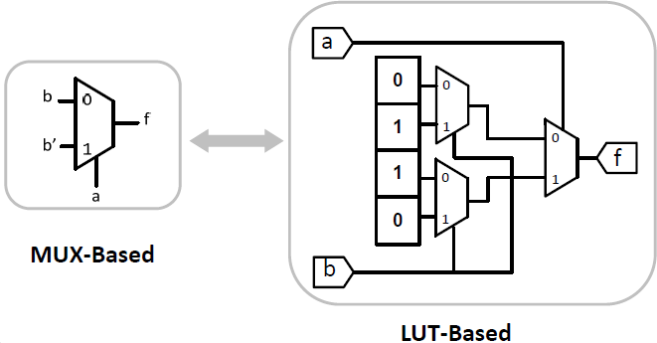
Comparison b/w MUX based and LUT based
Example:
Implementation p of an XOR in two cases:

Slide 28
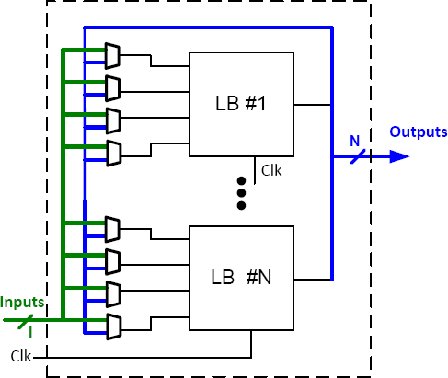
Logic Block Design: Granularity
❑ An alternative is to change the granularity of each logic block
It means to integrate a few logic blocks in a cluster (Clusters of LUTs)
Logic blocks in a cluster are programmably connected together by a local interconnect structure
This idea is used in most current commercial FPGAs

Slide 29
Logic Block Design: Granularity
In this approach the size of the logic and internal routing grows quadratically as opposed to the exponential growth for the LUT size
More area per logic block with less area increase
Thus, there are fewer inputs to the cluster from the external inter‐cluster routing than the total number of inputs to the basic logic blocks inside the cluster
As the functionality of a logic block (LB) increases:
Fewer LBs are used on the critical path (good)
Less inter‐logic routing, less delay, higher speed performance
The internal delay of each LB increases (bad)

Slide 30
Logic Block Design in Heterogeneous FPGAs
If there is a dedicated specific‐purpose hard circuit on the FPGA for a function, it has area speed and power consumption superior area, over its implementation
in general purpose logic blocks.
For instance, a Flip‐Flop (FF) can be built using LUTs and gates but it can also be explicitly designed or customized inside a logic block, much more efficient.
In all commercial heterogeneous FPGAs, various dedicated blocks are designated to improve area and speed efficiency.
What kind of specific functions should be included?

Slide 31
Logic Block Design in Heterogeneous FPGAs
Heterogeneity may exist in two levels:
Extra elements inside general purpose logic blocks: (Soft Logic)
Flip‐flops
MUXs
XOR
Blocks to support arithmetic carry, sum, and subtraction functions
Different of blocks: types (Hard Logic)
Multi‐bit block RAMs (first used in FLEX 10K)
Multiply‐accumulation (MAC) blocks (e.g., in Startix I, II, III)
Hard multiplier blocks (e.g., in Xilinx Virtex families)

Slide 32
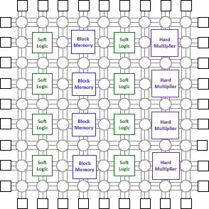
Logic Block Design in Heterogeneous FPGAs

Slide 33
Soft Logic in Heterogeneous FPGAs
Carry logic modules are dedicated blocks, provided to help implement faster addition operations
The carry over is passed b/w internal LUTs via dedicated routing
General routing is avoided to achieve less signal delay
❑ Normally an XOR gate is also included in the carry chain to generate the SUM to build an adder

Slide 34
Memory Blocks in Heterogeneous FPGAs
First appeared in Altera FLEX 10K
Flexibility of being configured in various aspect ratios is crucial
b/c different applications need different block sizes and aspect ratios
e.g., in Flex 10K a 2K memory in (1x2048), (2x1024), (256x8)
Covers a significant fraction of the FPGA die area
More important in larger systems
Most complementary FPGAs employ dual‐port memory blocks

Slide 35
Computation Oriented Blocks in Heterogeneous FPGAs
❑ Most common: Hard multiplier
❑ e.g., Virtex II contains 18x18 2’s complement multipliers
❑ Startix I contains a single 36x36 multiplier (can also be broken into eight 9x9 multipliers and an adder to sum the results)
If multipliers are not used by an application their blocks are wasted
In order to avoid waste of resources:
Multiple sub‐families of a device with different ratios of soft logic to hard logic are created (so choose the one that fits the best)
For example, Virtex 4/5 have three sub‐families:
More soft logic and memory
Focus on arithmetic unit
Focus on high‐speed interface

Slide 36
Microprocessors in Heterogeneous FPGAs
Microprocessors are vital in many digital systems
Often used in conjunction with FPGA logic
It is a great idea to integrate it with FPGAs on a single die
For example:
Xilinx Virtex II Pro FPGAs have 1, 2, or 4 IBM power PC cores integrated with Virtex II logic fabric
Virtex 4, 5 subfamilies also support power PC cores on the die

Slide 37
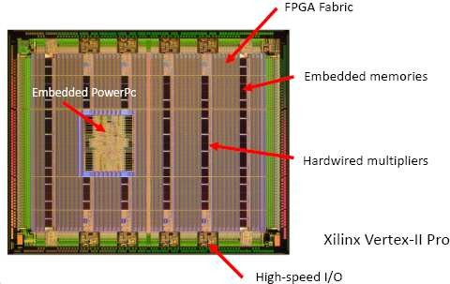
Heterogeneous FPGAs

Slide 38
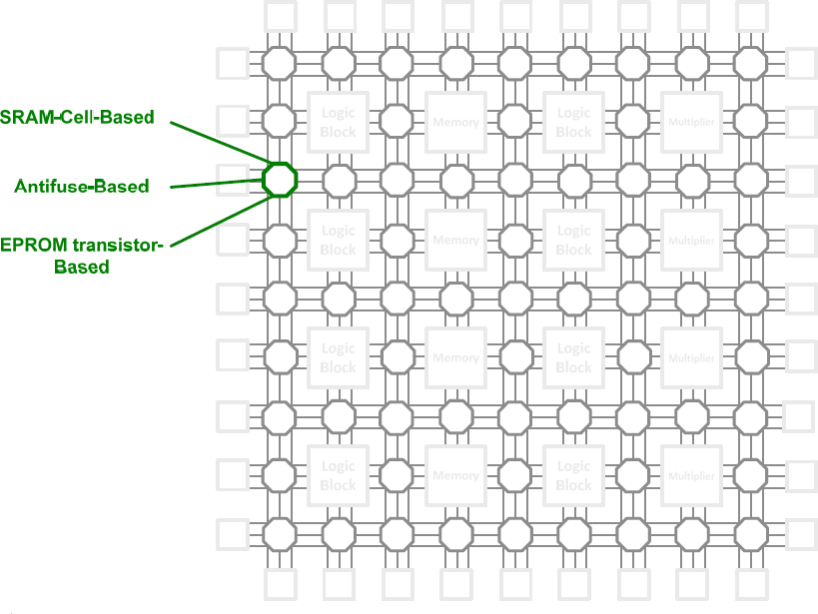
Programmable Switches

Slide 39
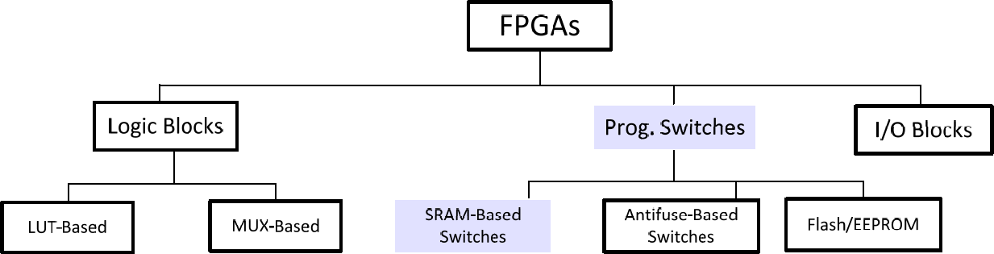
Where are we?

Slide 40
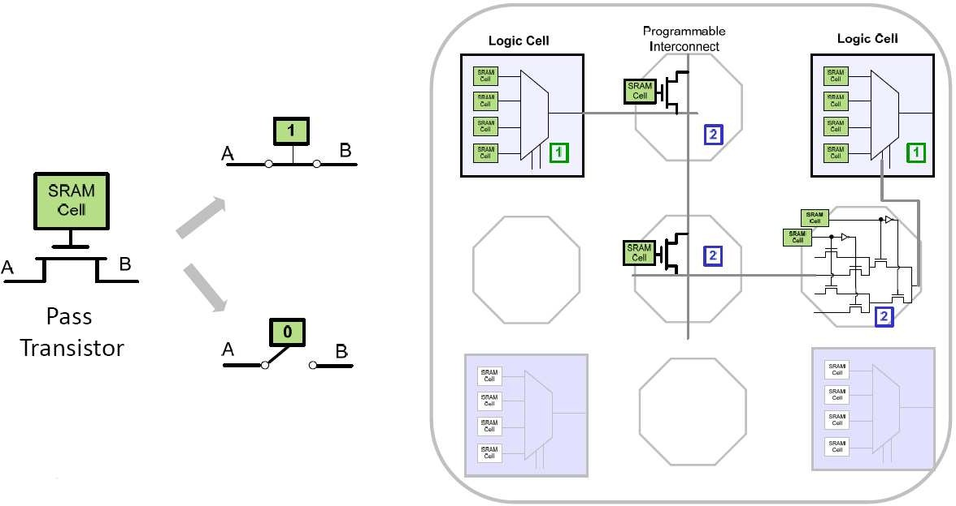
SRAM Based Programmable Switches
❑ SRAM Cell is used both in logic blocks and the Prog. Interconnections:
40

Slide 41
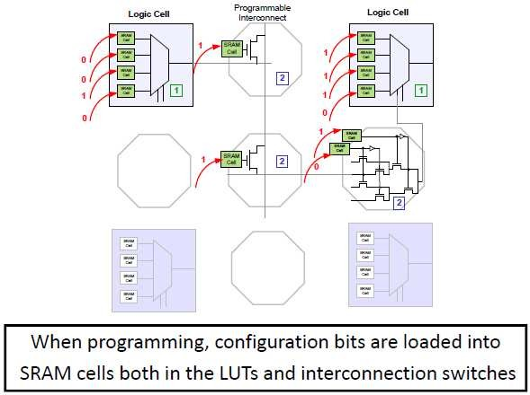
SRAM Based Programmable Switches

Slide 42
Configuration of SRAM based FPGA
SRAM‐based FPGAs are reconfigured by changing the content of the SRAM cells in LUTs and programmable interconnect
A few pins are dedicated for configuration
Two ways of configuration:
Download the configuration bits directly from PC using a download cable
Good for prototyping and debugging mode
Not reliable in the production mode
Store configuration bits in PROMs on the PCB with the FPGA
Upon power‐up they are loaded into the FPGA

Slide 43
FPGA Interconnect Design
Interconnect design is really important b/c the most area in an SRAM‐based FPGA is consumed by the routing switches.
Interconnects are organized in wiring channels or “routing channels”
A typical FPGA has many different kinds of interconnect to be fully customized for different delay/speed requirements:
Short wires
Global wires
General purpose wires
Clock distribution network

Slide 44
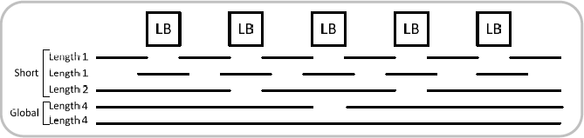
FPGA Interconnect Design
In order to make all required connections b/w logic blocks efficiently, FPGA routing channels have wires of a variety of lengths (segmentation)
Segmentation:
Short wires: Connect only local logic blocks (e.g., the carry chain in LBs)
Do not take up much area and have small delay
Global wires: Designed for long‐distance communication
May have built‐in electrical repeaters to reduce delay

Slide 45
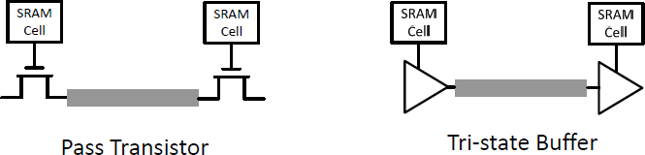
SRAM Based Programmable Interconnect
Interconnect design in SRAM‐Based FPGAs is tricky b/c the circuitry can introduce significant delay and cost a large silicon area.
Two options:
Pass transistor
Three‐state buffer (larger but provides amplification)

Slide 46
SRAM Based Programmable Interconnect
❑ These elements introduce delay to the interconnect
Objective: reduce the delay, How?
1. Increase the width of the transistors
❑ Less delay (good)
❑ More silicon area (bad)
2. Increase the wire width
Less resistance (good)
❑ More capacitance (bad)
❑ How much we should increase the width?
Define a metric: Area‐delay product (To consider both restrictions)

Slide 47
SRAM Based Programmable Switches
Advantages:
Re‐programmability (infinite number of times)
Use of standard CMOS fabrication process technology
Use of the latest CMOS technology
Benefits from increased integration, higher speed, lower dynamic power
Drawbacks:
Size: SRAM cell requires 6 transistors
Volatility: an external device (like an EPROM) is needed to permanently store the configuration bits when the device is powered down (extra cost)
Non‐ideal pass transistors: SRAM cells rely on pass transistors that have large on‐resistance and capacitance load
Reliability: the bits in the SRAM are susceptible to theft

Slide 48
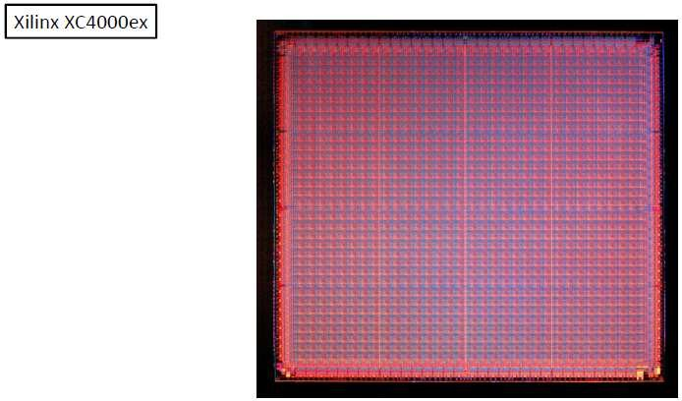
SRAM Based FPGA

Slide 49
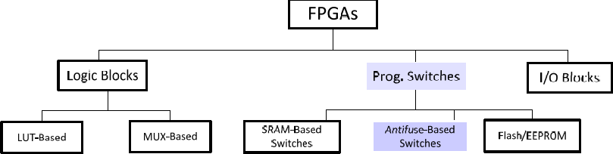
Where are we?

Slide 50
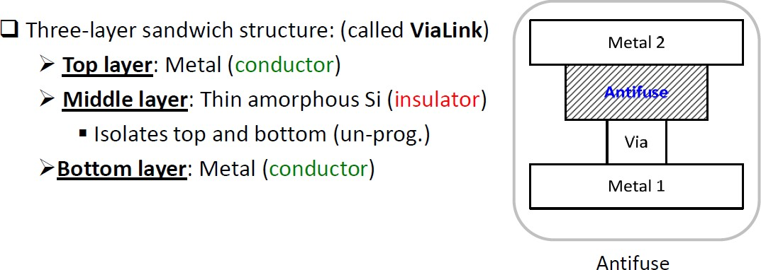
Antifuse Based Programmable Switches

Slide 51
Antifuse Based Programmable Switches
❑ The programmable element is an antifuse
Programmed by applying a voltage across it
❑ Normal condition: high resistance link
❑ When programmed (blown): low resistance (20‐100 Ohm)
Permanently programmed (unlike SRAM)
❑ Why antifuse? A high voltage blows the antifuse so it conducts
Why antifuse and not fuse?
Well, interconnect networks are sparsely populated, which means that most of them are not connected
So antifuse is used, which is an open circuit by default

Slide 52
Antifuse Based Programmable Switches
An antifuse slows down the interconnect path less than a pass transistor in a SRAM‐based FPGA.
To be able to program every antifuse, each antifuse is connected in parallel with a pass transistor
The pass transistor allows the antifuse to be bypassed during programming
Gates of the pass transistors are controlled to select the appropriate row & column for the desired antifuse
Voltage is applied across row/column so that only the desired antifuse receives the voltage.
FPGA has circuitry that allows each antifuse to be separately programmed
To program an antifuse‐based FPGA, chip is plugged into a socket on a special programming box that generates the programming voltage.

Slide 53
Antifuse Based Programmable Switches
Advantages:
Requires no silicon area (low area), more switches per device
Lower resistance and parasitic capacitance than other technologies
Non‐volatility means
Instant operation
No need for additional on‐chip memory (as opposed to SRAM‐based)
Drawbacks:
Requires non‐standard CMOS process
Behind SRAM‐based tech. in manufacturing
❑ Scaling challenges for antifuse
Hard to realize in deep sub‐micron
❑ Not re‐programmable

Slide 54
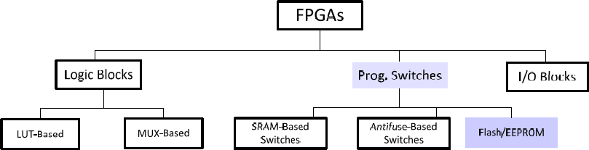
Where are we?

Slide 55
EEPROM/Flash Based Programmable Switches
❑ Advantages:
Non‐volatile, Does not lose information when the device is powered off (Thus no extra memory/flash is required)
Improved area efficiency (less transistors needed compared to SRAM‐cell)
Re‐programmable
❑ Drawbacks:
Tricky floating‐gate design
source‐drain voltage should be low enough to prevent charge injection into the floating gate
Can NOT be reprogrammed infinite number of times!
b/c of charge build‐up in the oxide (e.g., Actel ProASIC3 are rated for 500 times)
Uses non‐standard CMOS process
High resistance and capacitance due to the use of transistor‐based switches

Slide 56
Programmable Switches
❑ So there are three technologies for switches:
SRAM cell
Antifuse
Flash‐based
❑ The ideal technology is the one that is:
Non‐volatile
Reprogrammable infinite number of times
Based on standard cell CMOS process
Offer low on resistance and capacitance
❑ Recent trend by Xilinx, Altera and Lattice:
On‐chip flash memory for storage of configuration bits
SRAM‐based interconnect switches

Slide 57
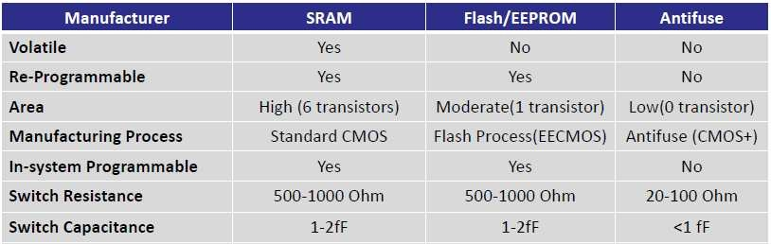
Programmable Switches

Slide 58
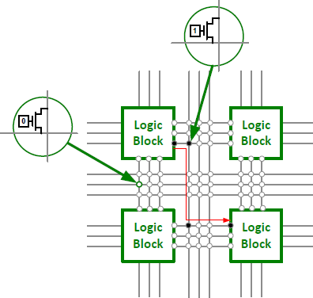
Routing Channels
❑ Interconnect wiring is grouped into routing channels, each of which contains a complete grid of horizontal and vertical wires.

Slide 59
Routing Channels
❑ FPGA wiring with programmable interconnect is slower than typical wiring in a custom chip b/c:
Pass transistor on an interconnect is not a perfect on‐switch
Programmable interconnect is slower than a pair of wires permanently connected by a via
FPGA wires are generally longer than would be necessary for a custom chip

Slide 60
FPGA Chip I/O
❑ I/O pins on a chip connect it to the outside world and perform some basic functions
Input pins provide electrostatic discharge (ESD) protection
Output pins provide buffers with sufficient drive to produce adequate signals on the pins
Three‐state pins include logic to switch b/w input and output modes
The pins on an FPGA can be configured to act as
Input pin
Output pin
Tri‐state pin

Slide 61
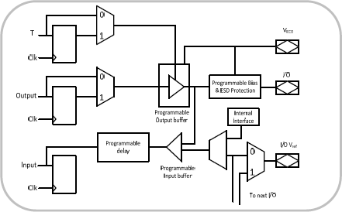

Xilinx Spartan II 2.5V Family I/O Pins (Ex.)
Supports a wide range of I/O standards
The I/O has three registers, one each for input, output and tri‐state operation
Each has its own enable signal
They all share the same clock connection
Can be configured as latch or FF
The Prog. delay on the input path is to eliminate variations in hold times from pin to pin

Slide 62

Commercial FPGA Products
Manufacturer | FPGA Products | Technology
Actel | MX,SX,eX,Axcelerator | Antifuse-based
QuickLogic | PASIC, QuickRAM, Eclipse (Plus/II) | Antifuse-based
Lattice | ECP2/M, SC | Antifuse-based
Atmel | AT40K, AT40KAL | LUT-based
Altera | Stratix, Cyclone, Arrira, Flex, … | LUT-based
Xilinx | Spartan (II,III,VI) , Virtex-(E,4,5,6,7) | LUT-based

Slide 63
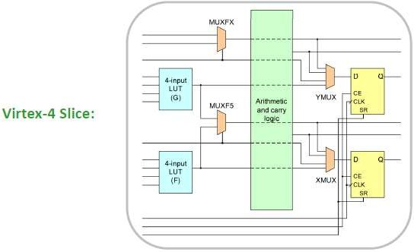
Xilinx (Virtex Series)
The elementary Prog. block in Virtex/Spartan FPGAs is called “Slice”
Two slices form a Configurable Logic Block (CLB)
Inside each Virtex 4 slice:

Slide 64
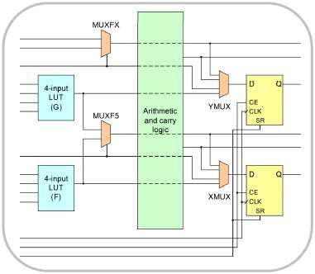
Xilinx Virtex 4 Slice Architecture
Two 4‐input LUTs (G, F)
Two dedicated user‐controlled MUXs for combinational logic
MUXF5 to combine outputs of G, and F to implement 5‐input combinational circuit.
MUXFX to combine outputs of the other MUXF5 and MUXFX (from the other slices).
Two 1‐bit registers (configured as FF or latches)
YMUX/XMUX to control the input to the registers
Dedicated arithmetic logic
Two 1‐bit adders
Carry chain
Two AND gates for fast multiplication

Slide 65
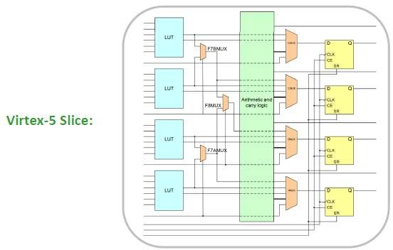
Xilinx (Virtex 5 Series)
The Virtex 5 Slice consists of four 6–input LUTs
As opposed to two 4‐input in Virtex 4

Slide 66
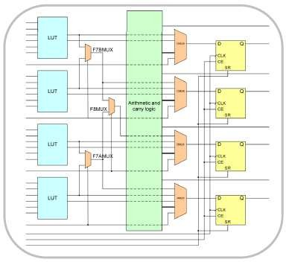
Xilinx Virtex 5 Slice Architecture
❑ Four LUTs that can be configured as:
6‐input LUTs with one output
5‐input LUTs with two outputs
❑ Three dedicated user‐controlled MUXs for combinational logic
F7AMUX/F F7BMUX to combine outputs of the LUTs to implement 7‐input combinational circuits.
F8MUX to combine outputs of F7AMUX/F7BMUX (or from the other slices).
Four 1‐bit registers (configured as FF or latches)
Dedicated arithmetic logic
Two 1‐bit adders
Carry chain
Two AND gates for fast multiplication

Slide 67
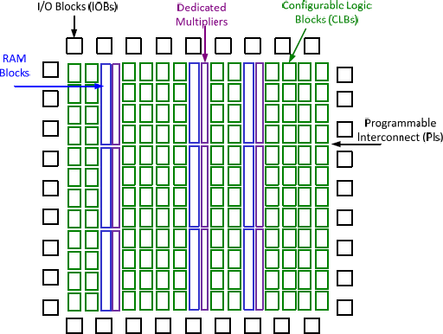
Xilinx Spartan II
❑ Heterogeneous blocks:

Slide 68
Altera (FLEX 8000 Series)
The logic block in Altera FPGAs is called Logic Element (LE)
FLEX8000 contains three main components
The main building block is called Logic Array Block (LAB)
Contains eight LUT‐based LEs
FastTrack interconnect
Horizontal and vertical to connect LABs
I/O pads

Slide 69
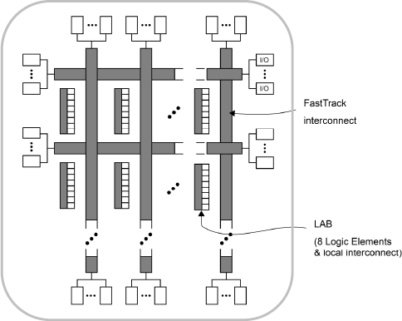
Altera (FLEX 8000 Series)
❑ Architecture of FLEX8000
LAB
FastTrack
I/O

Slide 70
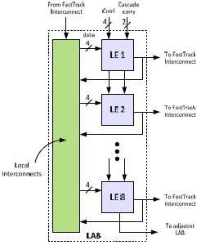
Altera (FLEX 8000 Series)
Each FLEX8000 LAB is a group of eight LEs
Each LAB:
Has a number of inputs provided from the adjacent row interconnect wires
Its outputs connect to the adjacent row/column wires
Contains local interconnects to connect any LE to another LE inside the same LAB
Connected to the global interconnect (fastTrack)
Similar to the Xilinx long lines

Slide 71
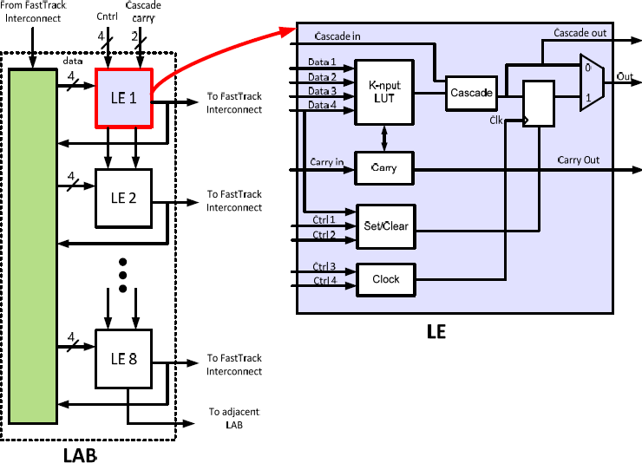
Altera (FLEX 8000 Series)
❑ Each FLEX8000 LE is LUT‐based and consists of :
➢
➢
➢
A 4‐input LUT A Flip‐Flops (FF) Carry circuitry
Cascade circuitry
(soft logic, coarse‐grained)
71

Slide 72
FPGA Specifications
Number of I/O Pads
Maximum clock frequency
Number of equivalent gates that can be filled
Amount of on‐chip memory blocks
Interfaces (such as PCI Express)
DSP Slices
On‐chip CPU

Slide 73
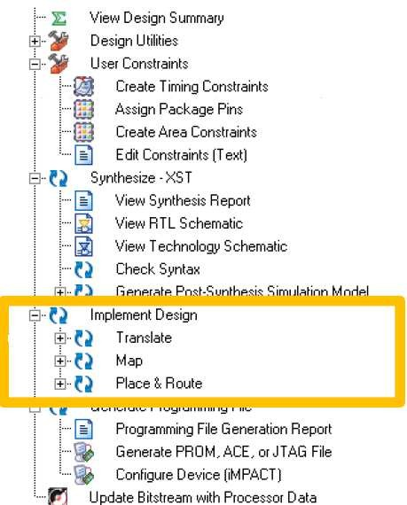
FPGA Design Flow (ISE)

Slide 74
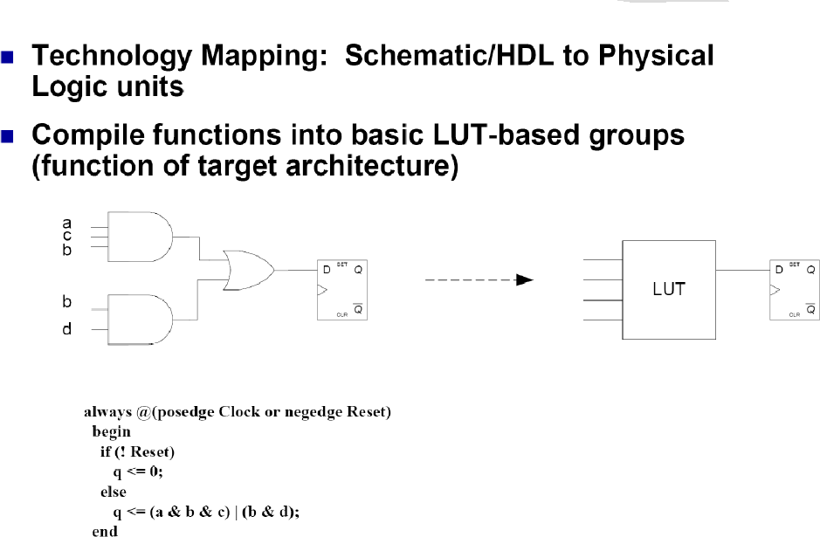
FPGA Design Flow (Mapping)
74

Slide 75
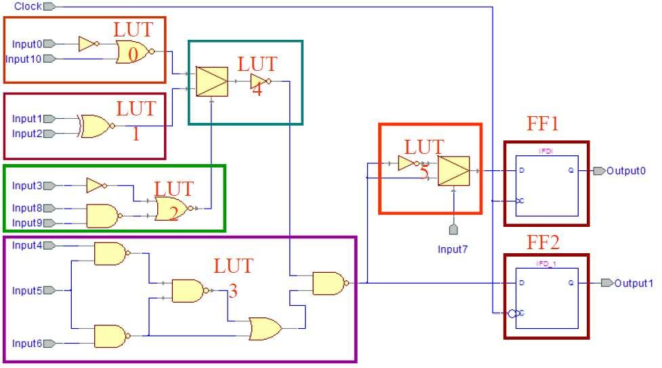
FPGA Design Flow (Mapping)

Slide 76
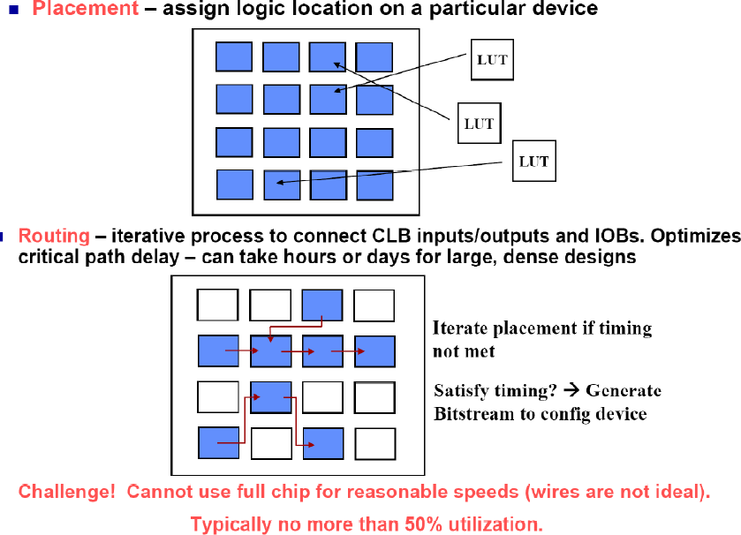
FPGA Design Flow (Place & Route)

Slide 77
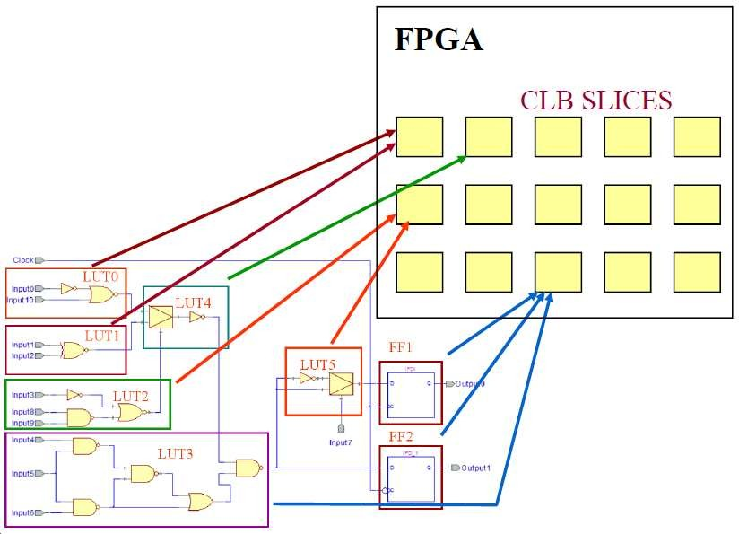
FPGA Design Flow (Placement)

Slide 78
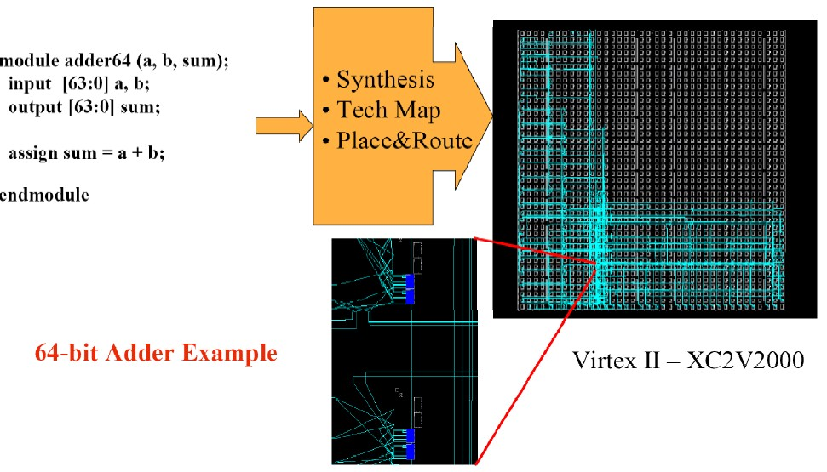
FPGA Design Flow: In a Glance

Slide 79
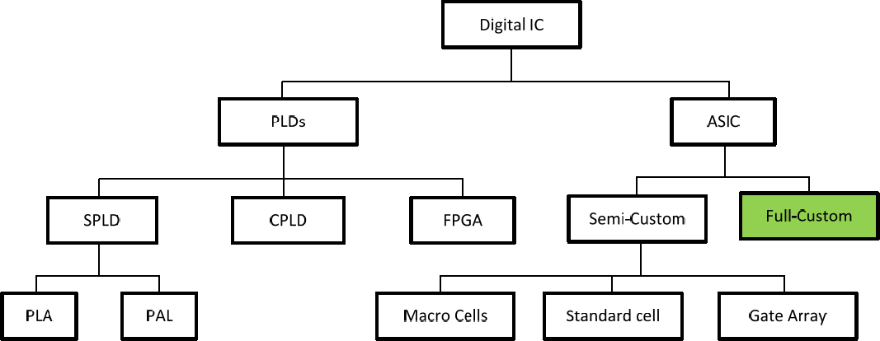
Where are we?

Slide 80
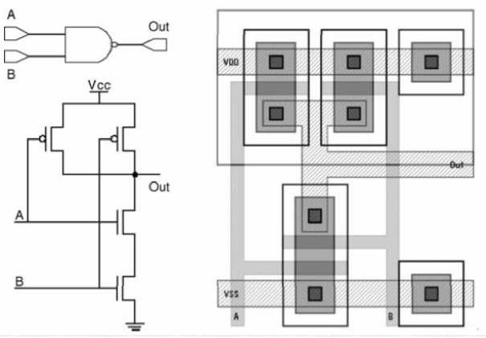
Full Custom VLSI Technology
All layers are optimized/customized for the particular implementation:
Placing transistors
Sizing transistors
Routing wires
Benefits:
Excellent performance
Small size
Low power
Drawbacks:
High NRE cost
Long time‐to‐market Not too common today!

Slide 81
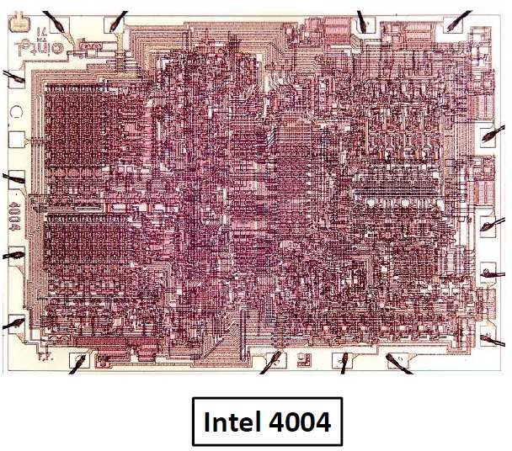
Full Custom VLSI Technology

Slide 82
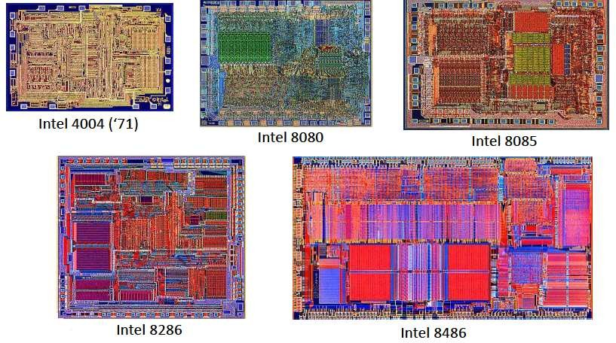
Transition to Automation and Regular Structures

Slide 83

Digital Logic Technology Tradeoffs (Reminder)
Full custom VLSI design
Speed / Density / Complexity / Likely Market Volume
ASICs
CPLDs FPGAs
PLDs
Engineering cost / Time to develop
83

